Slide 1
VaCraze
Josh Ilano, Ashtosh Bhandari, Xing Wang

Slide 2
Purpose
Let’s plan a family vacation, here is what we’ll need…
A map application (Google Maps or Waze) to pin the destinations we want to visit.
A planner app such as Google Calendars
An internet browser to look up reviews for certain places
A notes app to just keep track of everything
This is where our app, VaCraze comes in! Instead of working between many applications just to plan your trip or casually explore somewhere, we can condense all these functions into one app

Slide 3
Features
Trip Planning and Itinerary
Explore Nearby Destinations
Find Points of Interest
Display nearby restaurants, attractions, landmarks, and other points of interest, complete with details such as photos, reviews, and directions.
Users will be able to plan their trips by adding their chosen destinations and attractions to an itinerary, complete with routes and transportation suggestions.
Users can find their dream destination by filtering results based off of location, category, or interests.
Personalized Recommendations
Sensor Integration
Using user preferences, previous searches, and location data, the app will provide tailored recommendations for destinations and activities.
The app will utilize onboard sensors like GPS to offer location-based recommendations, allowing users to discover nearby points of interest as they explore.

Slide 4
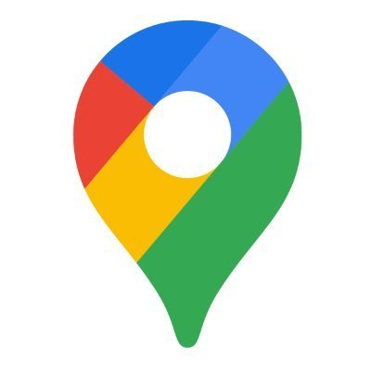


APIs
Google Places API: To retrieve detailed information about destinations, attractions, restaurants, and other points of interest, along with maps and directions.
Yelp API: To fetch restaurant information, including ratings, reviews, photos, and user-generated content.
OpenWeather API: To provide users with weather forecasts for their chosen destinations, helping them plan accordingly.

Slide 5
UI
Planning is stressful, and our app aims to reduce this stress by making the UI as user-friendly as possible. One of our biggest features is viewing the daily schedule. We will represent this as a scrollable single bar, where color-coded blocks will represent events (e.g. dinner, movies).
We will also make them editable through drag and drop, and pinch and expand gestures.
For accessibility, we will simply include voice search so that users can have a gesture-free experience when searching up their dream destinations.

Slide 6
Database
Destination, Locations of interest, Itineraries.
Firebase
Cloud Firestore:
Ease of scaling
Offline support → cache data locally and synchronize with server later
Real time capabilities
Work with external real-time data sources, allowing the app to fetch latest data from sources like Google Places and Yelp using API integration.

Slide 7
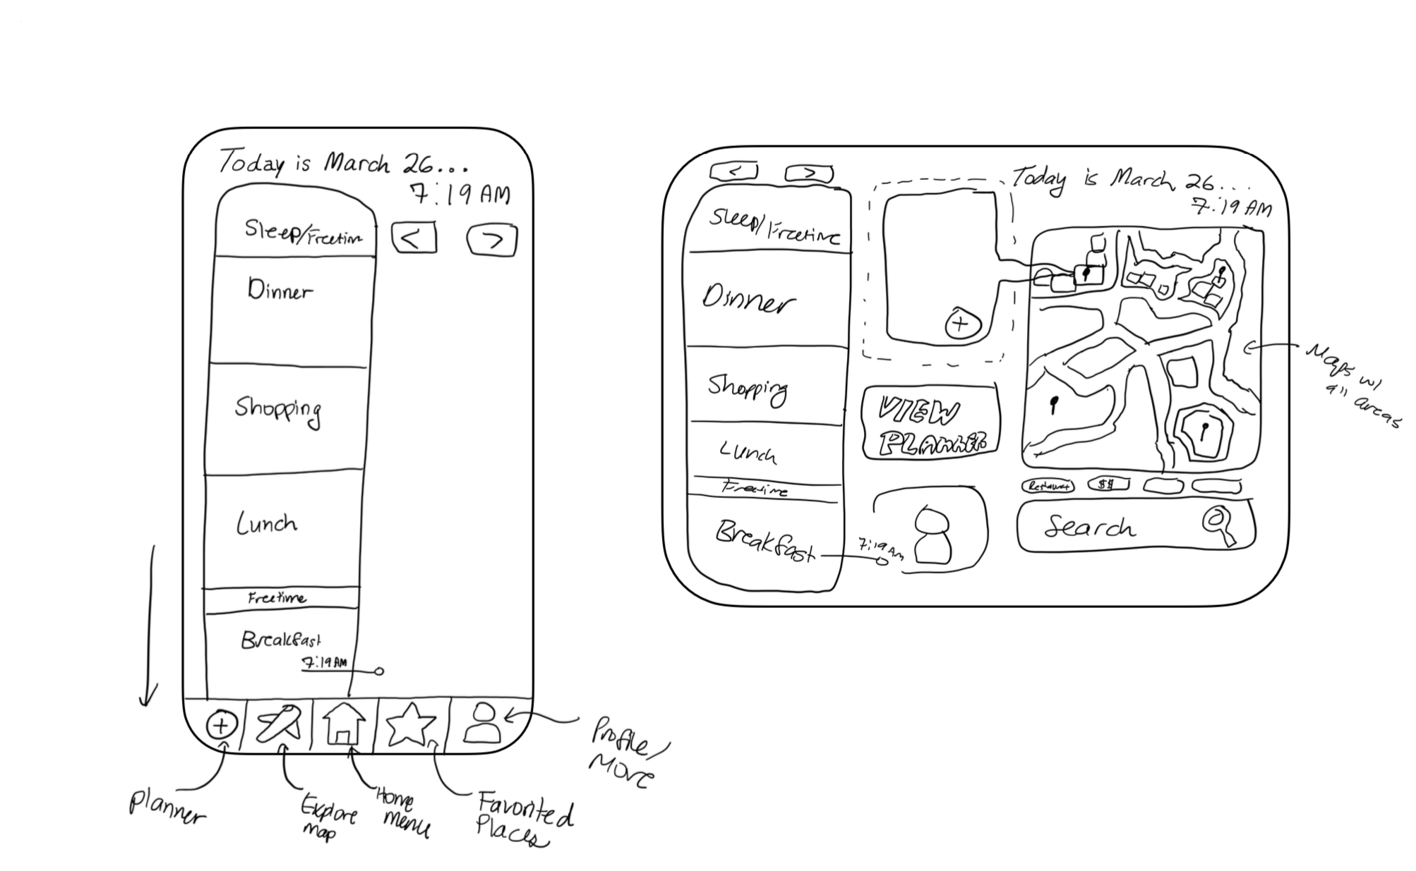
Schematic

